Slide 1
MAX Power Lab Collection

Slide 2
Agenda
Clark Center Overview
Max Power Collection
Demo
How you can contribute

Slide 3
Clark Center
Best resource for free curriculum
https://clark.center/home

Slide 4
What is Clark?
“CLARK, the Cybersecurity Labs and Resource Knowledge-base, is a platform for building and sharing free cybersecurity curricula. It includes a model for building curriculum, the digital library system, and distinct curriculum collections.”
Source: Clark website

Slide 5
Who is Clark For?
“CLARK is for cybersecurity faculty and general users wanting to prepare for the next cybersecurity workforce. The range of academic levels that can be taught through CLARK goes from K - 12 to all of higher academia along with industry training. CLARK focuses on two main users: consumers and contributors.
Consumers are registered users who want to download any content on CLARK.
Contributors are registered users who want to provide their curriculum to CLARK for consumers to download.”
Source: Clark website

Slide 6
Mission of Clark
“CLARK aims to secure the nation through education. Our platform provides cybersecurity educators with a high-quality and high-availability repository for curricular resources for the cybersecurity education community. It provides cybersecurity educators with the building blocks to train the next wave of researchers and better prepare the cybersecurity workforce.”
Source: Clark website

Slide 7
Philosophy of Clark
Source: Clark website

Slide 8
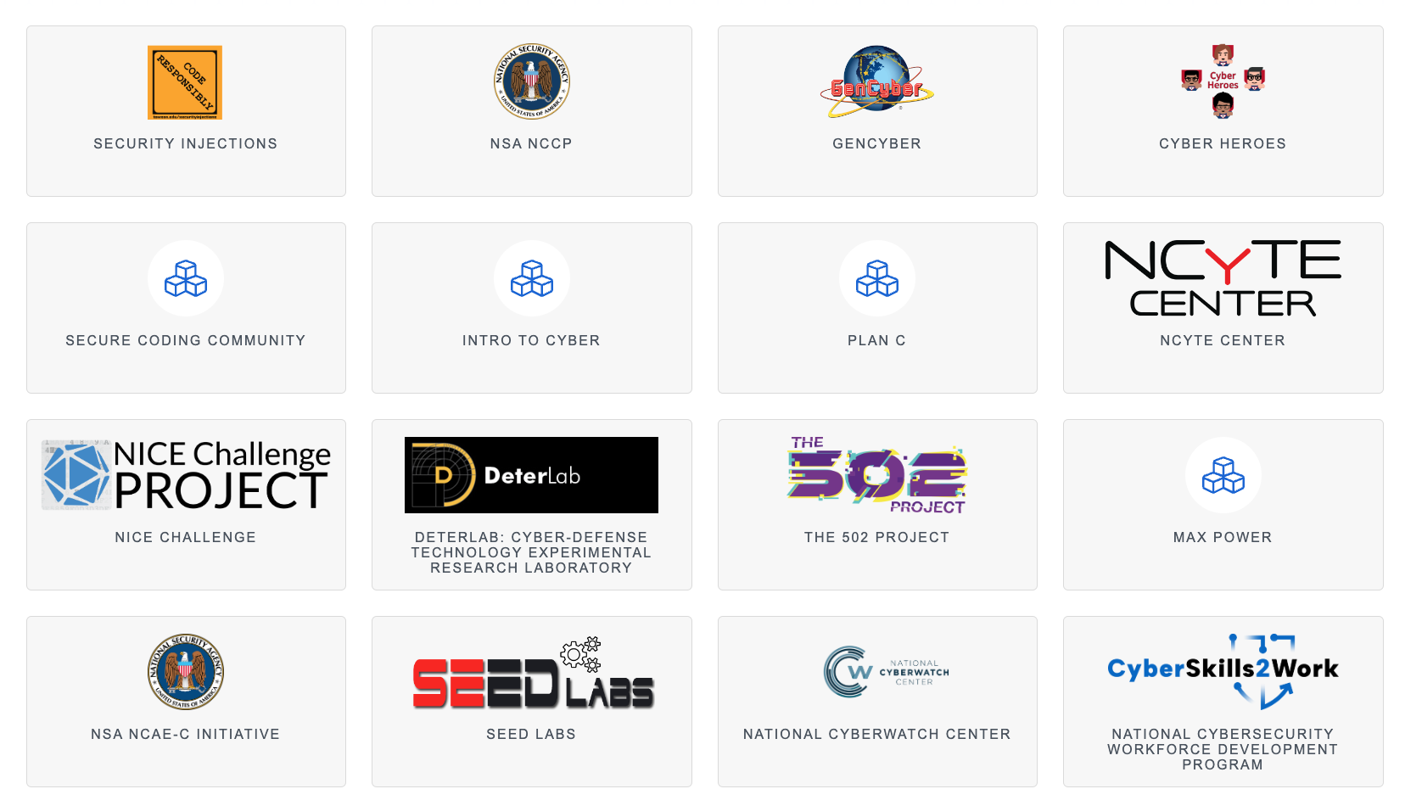
Collections
“Learning Objects are grouped into Collections within CLARK. Each collection is unique, has its own peer-review process, and is supported by its own community.”
Source: Clark website

Slide 9
Background
Hands on labs are a critical component of any cybersecurity program and a requirement to become an NSA/DHS Center of Academic Excellence
Hands on labs allow students to demonstrate skills for potential employers
There are a significant number of free or low cost lab environments
Finding and mapping these labs to courses can be time consuming

Slide 10
Max Power Collection
Collection of free labs that support cybersecurity curriculum
Hosted by independent vendors

Slide 11
Max Power Collection
Collection of free labs that support cybersecurity curriculum
Hosted by independent vendors

Slide 12
Caveats
Not an official endorsement of any provider by any government agency, Clark Center, or National University
Need to create accounts on vendor site

Slide 13
What’s Included
Name of lab and lab provider
Link to lab
Outcomes mapped to NICE Framework and KU’s (depends on lab)
Recommended levels
Additional references
Some modules on accessing labs

Slide 14
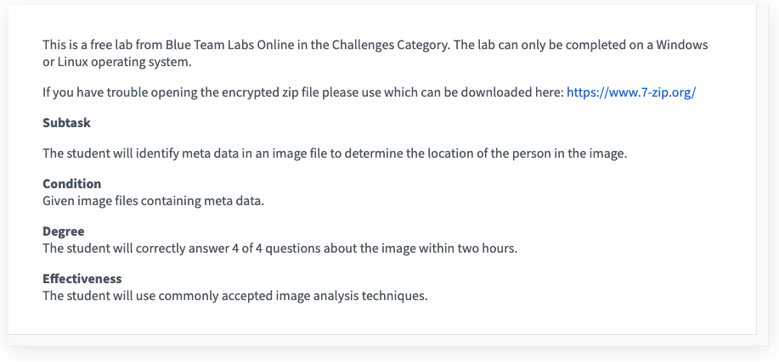
Draft Competency Statements
Located in notes section
Examples only

Slide 15
Demo Time

Slide 16
How You Can Help
Submit labs
Provide feedback
Report Broken Links

Slide 17
Questions and Contact Info
csimpson@nu.edu

